Slide 1
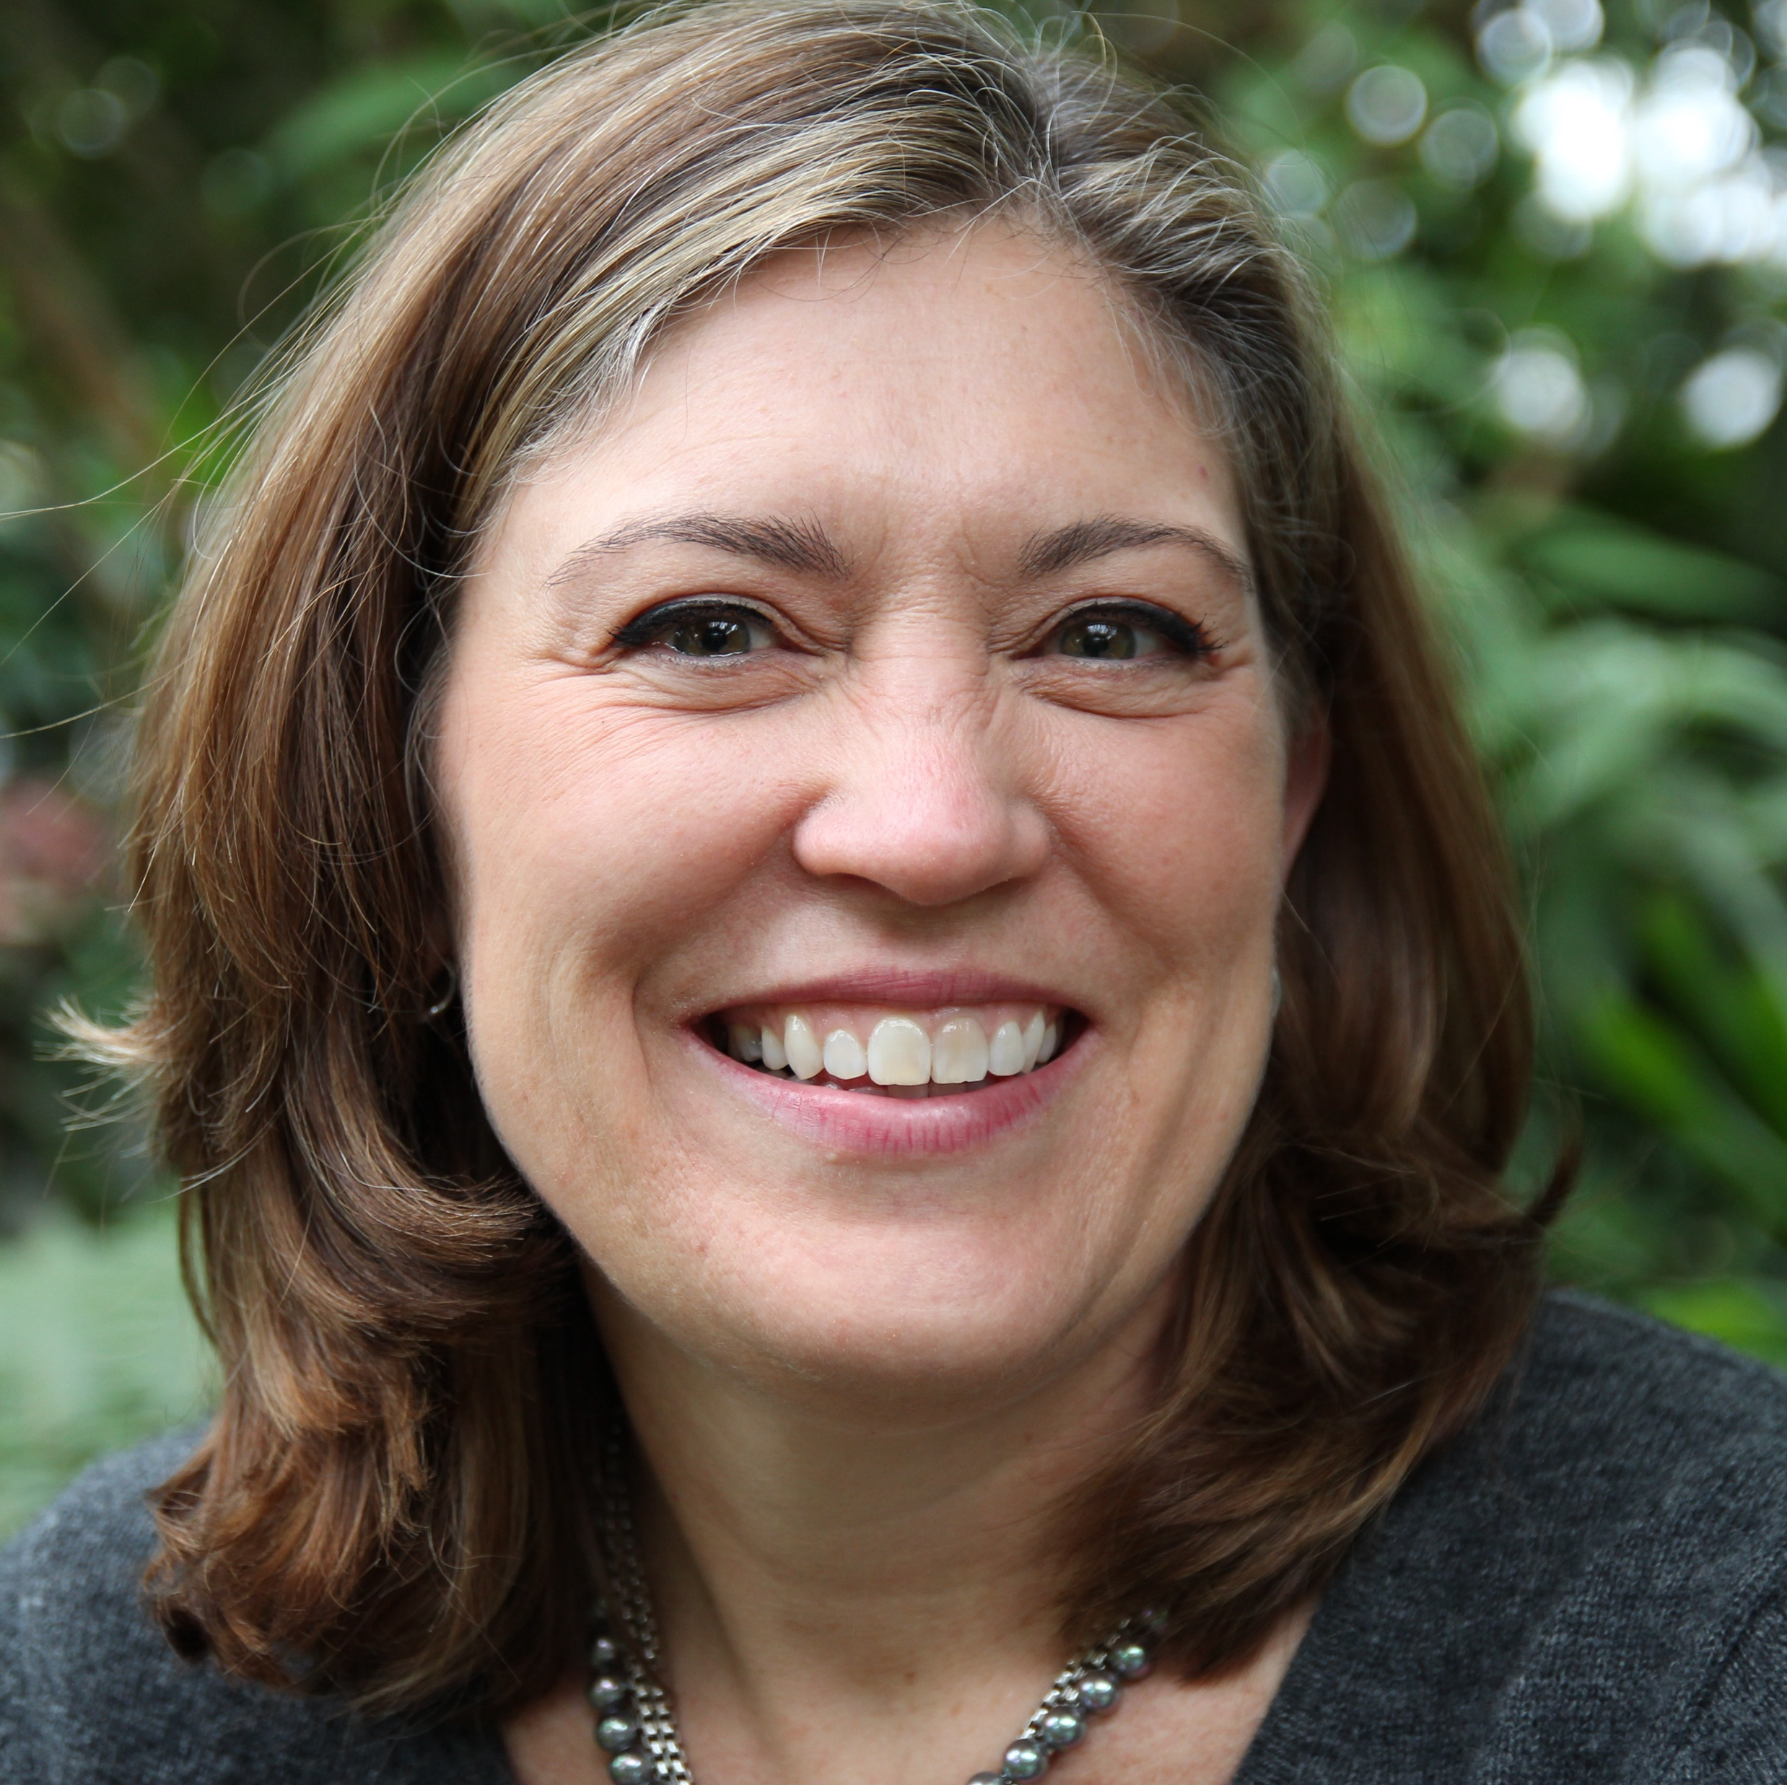



Natalie D. Hanson, Ph.D. — Fractional Executive
Operator · Advisor · Investor · Anthropologist
I build the capabilities fast-growing technology companies don't yet have — ten times, at every stage of the product, commercial, and customer lifecycle. When you're at an inflection point, I've likely been there before.
Through NDH Advisory, working with enterprise software, professional services, and health technology companies at inflection points — scaling, pivoting, or rebuilding what isn't working
At ZS Associates, launched a digital solutions practice from zero to $30M in net new revenue in under two years; team grew to 300 people across three continents
At SAP, ran strategic programs for C-suite and board leadership as the company scaled from 11K to 85K people
Trained as an anthropologist and active investor, I pay close attention to the humans inside complex systems — which is why the things I build tend to last. A long-term commitment to health equity — in women's health and in LGBTQ+ care — reflected in how I invest, advise, and engage.
https://www.linkedin.com/in/nataliehanson
http://www.nataliehanson.com
http://www.calendly.com/nataliehanson
hello@nataliehanson.com
+1 847.971.2061 (U.S. Central time)

